Slide 1
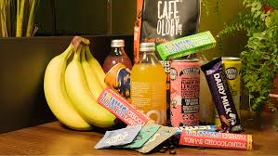

PYTHON PROECT PRESENTATION
DAILYDASH
An exploratory analysis to help DailyDash outlet identify metrics, performance and efficiency
BY: MABEL FAFALI KWADZO

Slide 2

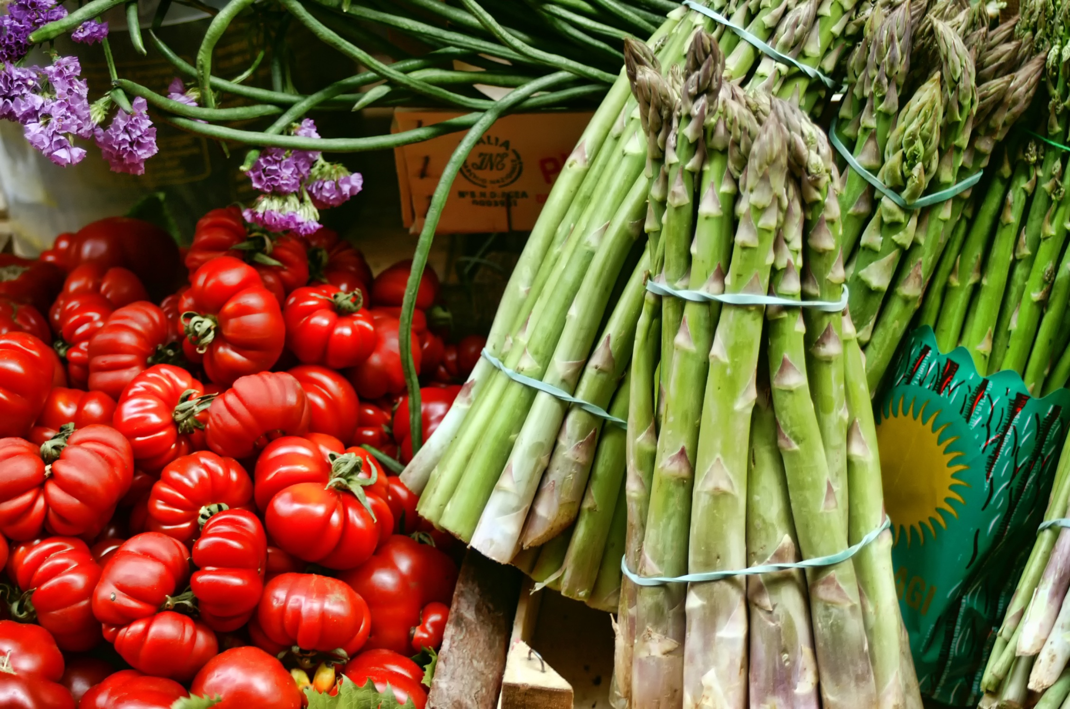
Introduction
This project involves performing a comprehensive sales and performance analysis for DailyDash, a retail business. The goal is to uncover actionable insights from sales, customer ratings, and outlet characteristics to help improve business decision-making and operational efficiency. The analysis focuses on key performance indicators (KPIs) and visually-driven insights using Python's data analysis and visualization libraries.
01

Slide 3
Business Requirements
To conduct a comprehensive analysis of DailyDash’s sales performance, customer satisfaction, and to identify key insights and opportunities for optimization using KPI’s and visualization
Sales performance across different item types and outlet characteristics Customer satisfaction through average item ratings.
Inventory distribution based on outlet establishment year, location, and size.
Category-based comparisons such as fat content and item type.
02

Slide 4
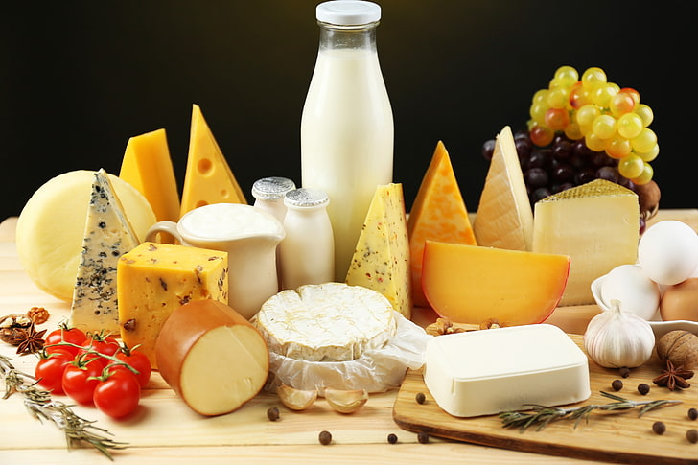
KPI’s
$1.2M
Total Sales: $1,201,681
Average Sales: $141
No of Items Sold: 8,523
Average Rating: 4
03
TOTAL SALES
$141
8,523
4
AVG. SALES
ITEMS SOLD
AVG. RATING

Slide 5
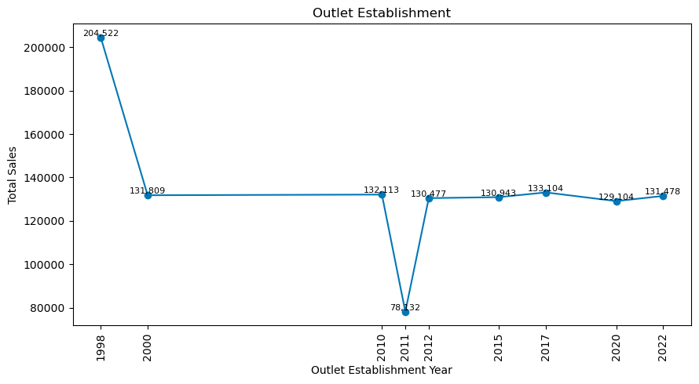
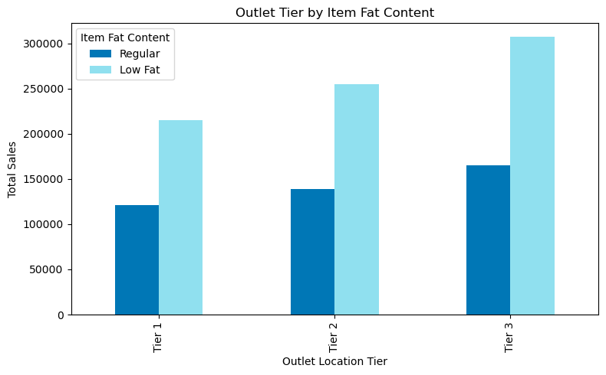
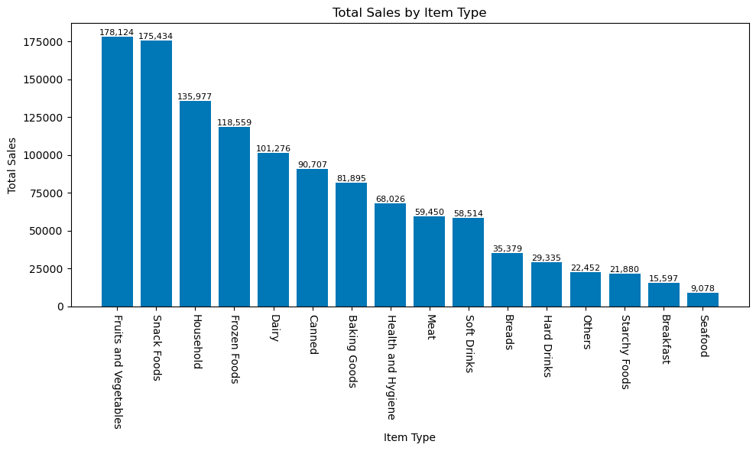
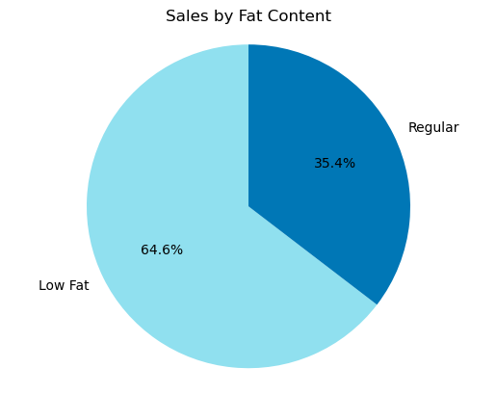
Chart’s Requirements
04

Slide 6
Insights
01
DailyDash recorded over 1.2 million dollars in total sales across 8,523 entries with an average sales value approximately $141 per item.
02
Top 3 performing categories include Fruits and Vegetables, Snack Foods and Household.
Lower-performing categories include Seafood ,Breakfast and Starchy Food.
05
03
Tier 3 outlets generated the highest sales volume, followed by Tier 2.
This is due to more store presence in Tier 3 areas with 3350 and Tier 2 with 2785 outlet opened.
04
Medium-sized outlets lead in total sales, followed by small, then large outlets.

Slide 7
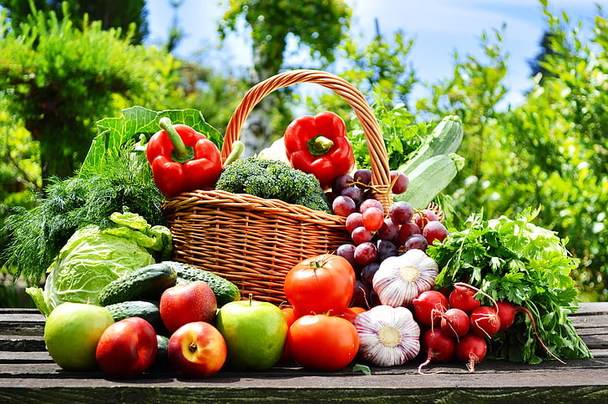
Conclusion
06
The business is performing well with over $1M in total sales and a decent average rating of 4
A strong consumer preference for low-fat products indicates health-conscious buying habits.
Fruits, vegetables, and snack foods are the most popular categories, suggesting opportunities for expansion or promotions in these areas.

Slide 8
Thank You

